Slide 1
31/03/2022
Title: Factorising continued
Aim:
Be able to factorise expressions and simplify expressions.
Plan:
Daily review
Directive numbers
Checking through substitution and evaluation.
What is HCF?
Steps to factorise
Independent practice.

Slide 2
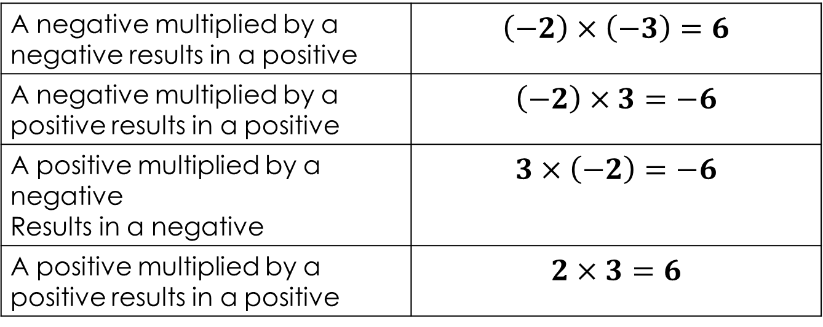
Directive numbers
A negative multiplied by a negative results in a positive | $$\left(−2\right)×\left(−3\right)=6$$
A negative multiplied by a positive results in a positive | $$\left(−2\right)×3=−6$$
A positive multiplied by a negative Results in a negative | $$3×\left(−2\right)=−6$$
A positive multiplied by a positive results in a positive | $$2×3=6$$

Slide 3
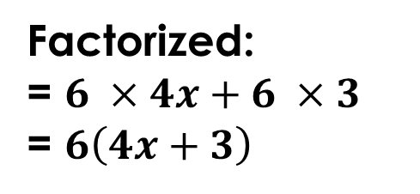
Refresh
HCF
Highest common factor.
The highest number that goes into both or all terms.
E.g., 24x + 18
Factors of 24x: 1, 2, 3, 4, 6, 8, 12, 24, x
Factors of 18: 1, 2, 3, 6, 9, 18
Factorized:
= $6 ×4x+6 ×3$
= $6\left(4x+3\right)$

Slide 4
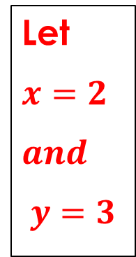
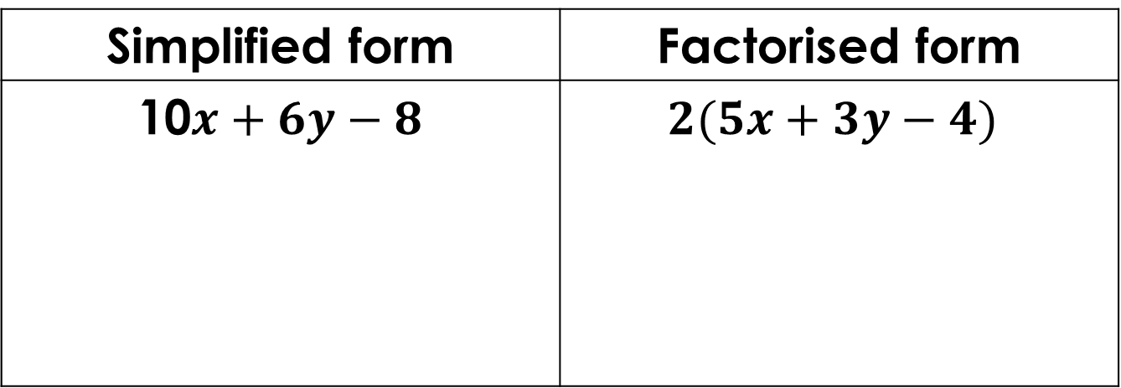


The factorisation process
Look for highest common factor (HCF).
Write terms as a product of factors using HCF.
Take highest common factor to front of brackets.
Checking through substitution and evaluation
Replace variable in the original and final expression with a number to check if they are the same
Simplified form | Factorised form
10$x+6y−8$ | $$2(5x+3y−4)$$
Let
$$x=2$$
$$and$$
$$y=3$$
$$10×2+6×3−8$$
$$20+18−8$$
$$30$$
$$2(5×2+3×3−4)$$
$$2\left(10+9−4\right)$$
$$2×15$$
$$30$$
They should be the same

Slide 5
https://www.youtube.com/watch?v=3DMFb_7m6mo
Works better if copy and paste link into google chrome.
Do the practice 3 from video (requires you to pause)

Slide 6
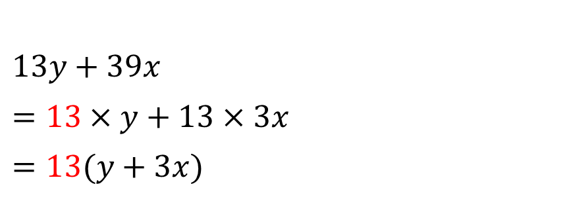

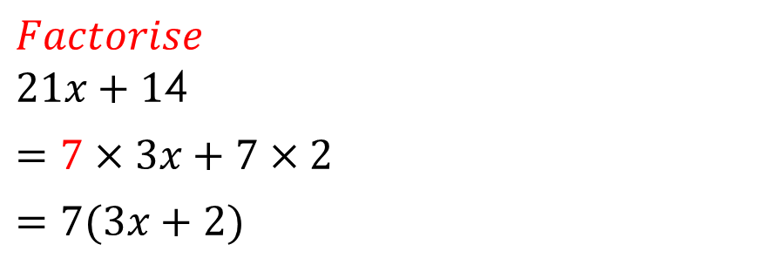

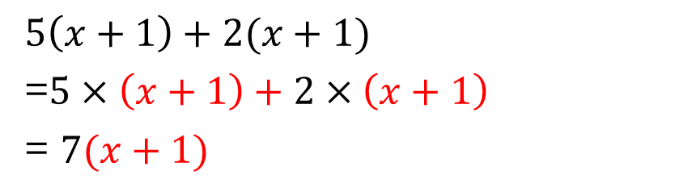
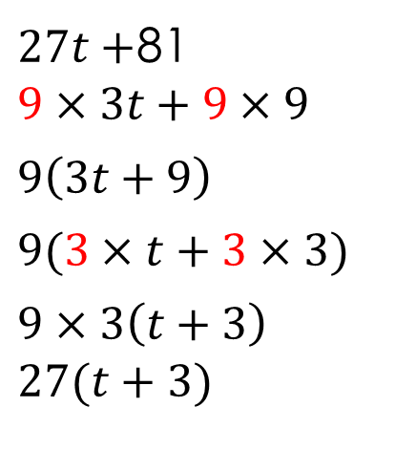
Exercise books
Steps:
Look for highest common factor
Write terms as a product of factors using HCF
Take highest common factor to front of brackets.
$Factorise$
$21x+1$4
$=7×3x+7×2$
$=7(3x+2)$
HCF = 7
$27t+$81
$$9×3t+9×9$$
$$9\left(3t+9\right)$$
$$9(3×t+3×3)$$
$$9×3\left(t+3\right)$$
$$27(t+3)$$
HCF = ?
$13y+39x$
$=13×y+13×3x$
$=13(y+3x)$
HCF = 13
$5\left(x+1\right)+2(x+1)$
=$5×\left(x+1\right)+2×\left(x+1\right)$
= $7(x+1)$
HCF = $(x+1)$
Check by substituting in a value for $x$

Slide 7
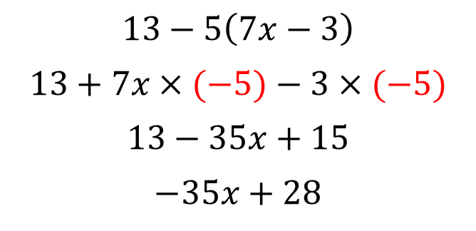
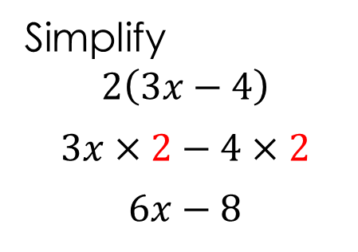
Exercise books
Simplify
$$2\left(3x−4\right)$$
$$3x×2−4×2$$
$$6x−8$$
Steps:
Expand brackets
Collect like terms
$$13−5\left(7x−3\right)$$
$$13+7x×(−5)−3×(−5)$$
$$13−35x+15$$
$$−35x+28$$

Slide 8

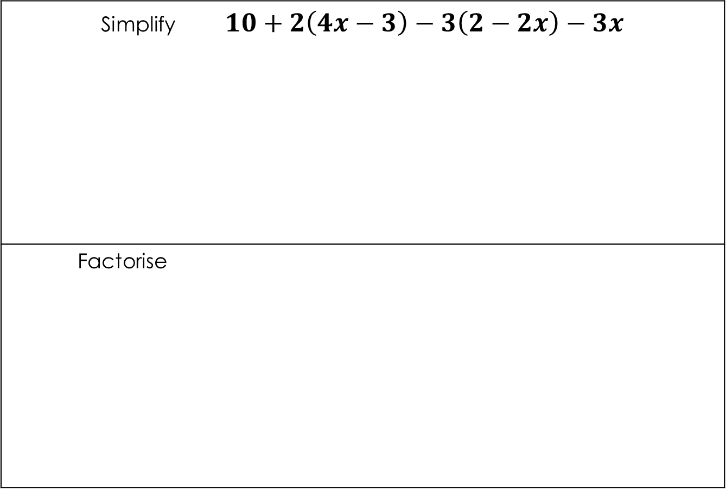


Exercise books
Simplify $10+2\left(4x−3\right)−3\left(2−2x\right)−3x$
Factorise
$$11x−2$$
$$36x −120$$
$$12(3x−10)$$

Slide 9

Individual practice
Working in book answers on sheet

